Slide 1
Microservices

Slide 2
What are microservices?
In simple terms microservices are used to form complex/large applications by using small, autonomous (independent), replaceable processes that interact by using small scale/lightweight APIs that do not depend on language.
Microservices are distributed – as they have the ability to share similar process across multiple apps and loosely coupled.

Slide 3
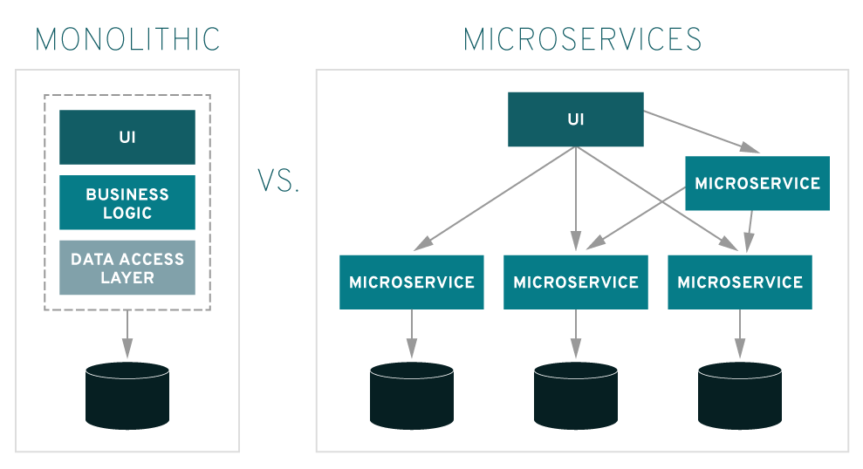
Microservices Architecture

Slide 4
Benefits of a Microservices Architecture
Application components can be built in different languages
Scalable
Individual continuous development and deployment streams can be sustained
Isolation and loose-coupling enables compartmentalized upgrades and enhancements
Failure isolation
Decentralized governance

Slide 5
Microservices Design patterns
1. Aggregator – refers to a program that collects related sets of information and displays them.
DB
Service A
Aggregator
Service B
DB

Slide 6
2. API Gateway – are services that acts as an entry point to forward the client’s request to the appropriate microservices. A common example usage of this pattern are mainly used for authentication/authorization
e.g. SSO service.
Login Service
DB
Client
API Gateway
Main App
DB

Slide 7
3. Chained or Chain of Responsibility Pattern – as the name implies, this pattern produces a single output which is a combination of multiple chained outputs.
Service A
Service B
Service C
DB
DB

Slide 8
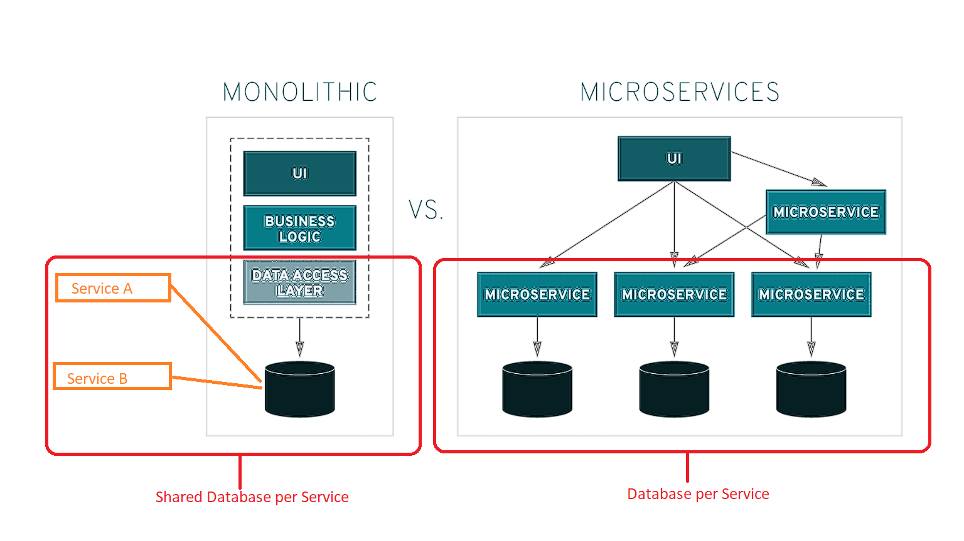
4. Database Pattern – this mainly focuses on the utilization of the services’ database.
Database per service – only works in a decoupled application environment. This mean that services are loosely coupled and they can be developed, deployed and scaled independently.
Shared Database per Service – though it is not ideal, but this is a good start to break the application into smaller modular services. (e.g. A monolithic application trying to break into microservices.)

Slide 9
Introduction to Spring Boot
Spring Boot provides implementation for creating microservices based on an opinionated view of what technologies should be used. Spring Boot applications are Spring applications, and use a programming model unique to that ecosystem.
Spring Boot applications can be packaged to run as an application hosted by an application server, or run as a runnable .jar file containing the composition of dependencies and some type of embedded server (usually Tomcat). Spring Boot highlights convention over configuration, and uses a combination of annotations and classpath discovery to enable additional functions.
Features
Create stand-alone Spring applications
Embed Tomcat / Jetty directly - no need to deploy Web Application Resource or Web Application Archive (WAR) files
Provide opinionated 'starter' dependencies to simplify your build configuration
Automatically configure Spring and 3rd party libraries whenever possible
Absolutely no code generation and no requirement for XML configuration

Slide 10
Setting up your computer
Things to install:
  An integrated development environment (IDE). https://www.eclipse.org/downloads/packages/release/2021-03/r/eclipse-ide-enterprise-java-and-web-developers
  JDK 1.8 or later https://www.oracle.com/sg/java/technologies/javase-downloads.html

